Slide 1
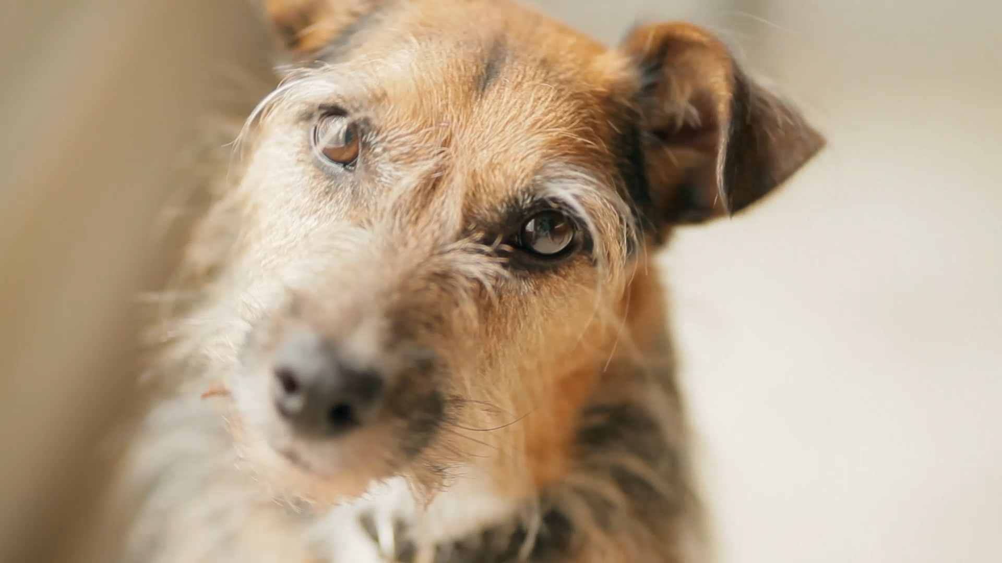
Making a Decision Maths and Neuroscience of Decision Making
Dr John Butler TU Dublin (Lecturer in Mathematics and Statistics)
Notes:
Possible titles:
the mathematics of decision making (original)
How do we make decisions?
1, 2, 3, I’ll pick thee: how does the brain make decisions? (also: eenie meenie miney mo: I’ll pick you)
Welcome to neuromatch for kids - and of course, also a special welcome to those of all ages who are young at heart.
Today we will learn how we make decisions. You make many decisions each day: what you’d like to eat for lunch, if you should wear a raincoat or just a t-shirt, and whether it’s safe to cross the street. Today we will play an escape room game, where your decision is to pick an escape.

Slide 2

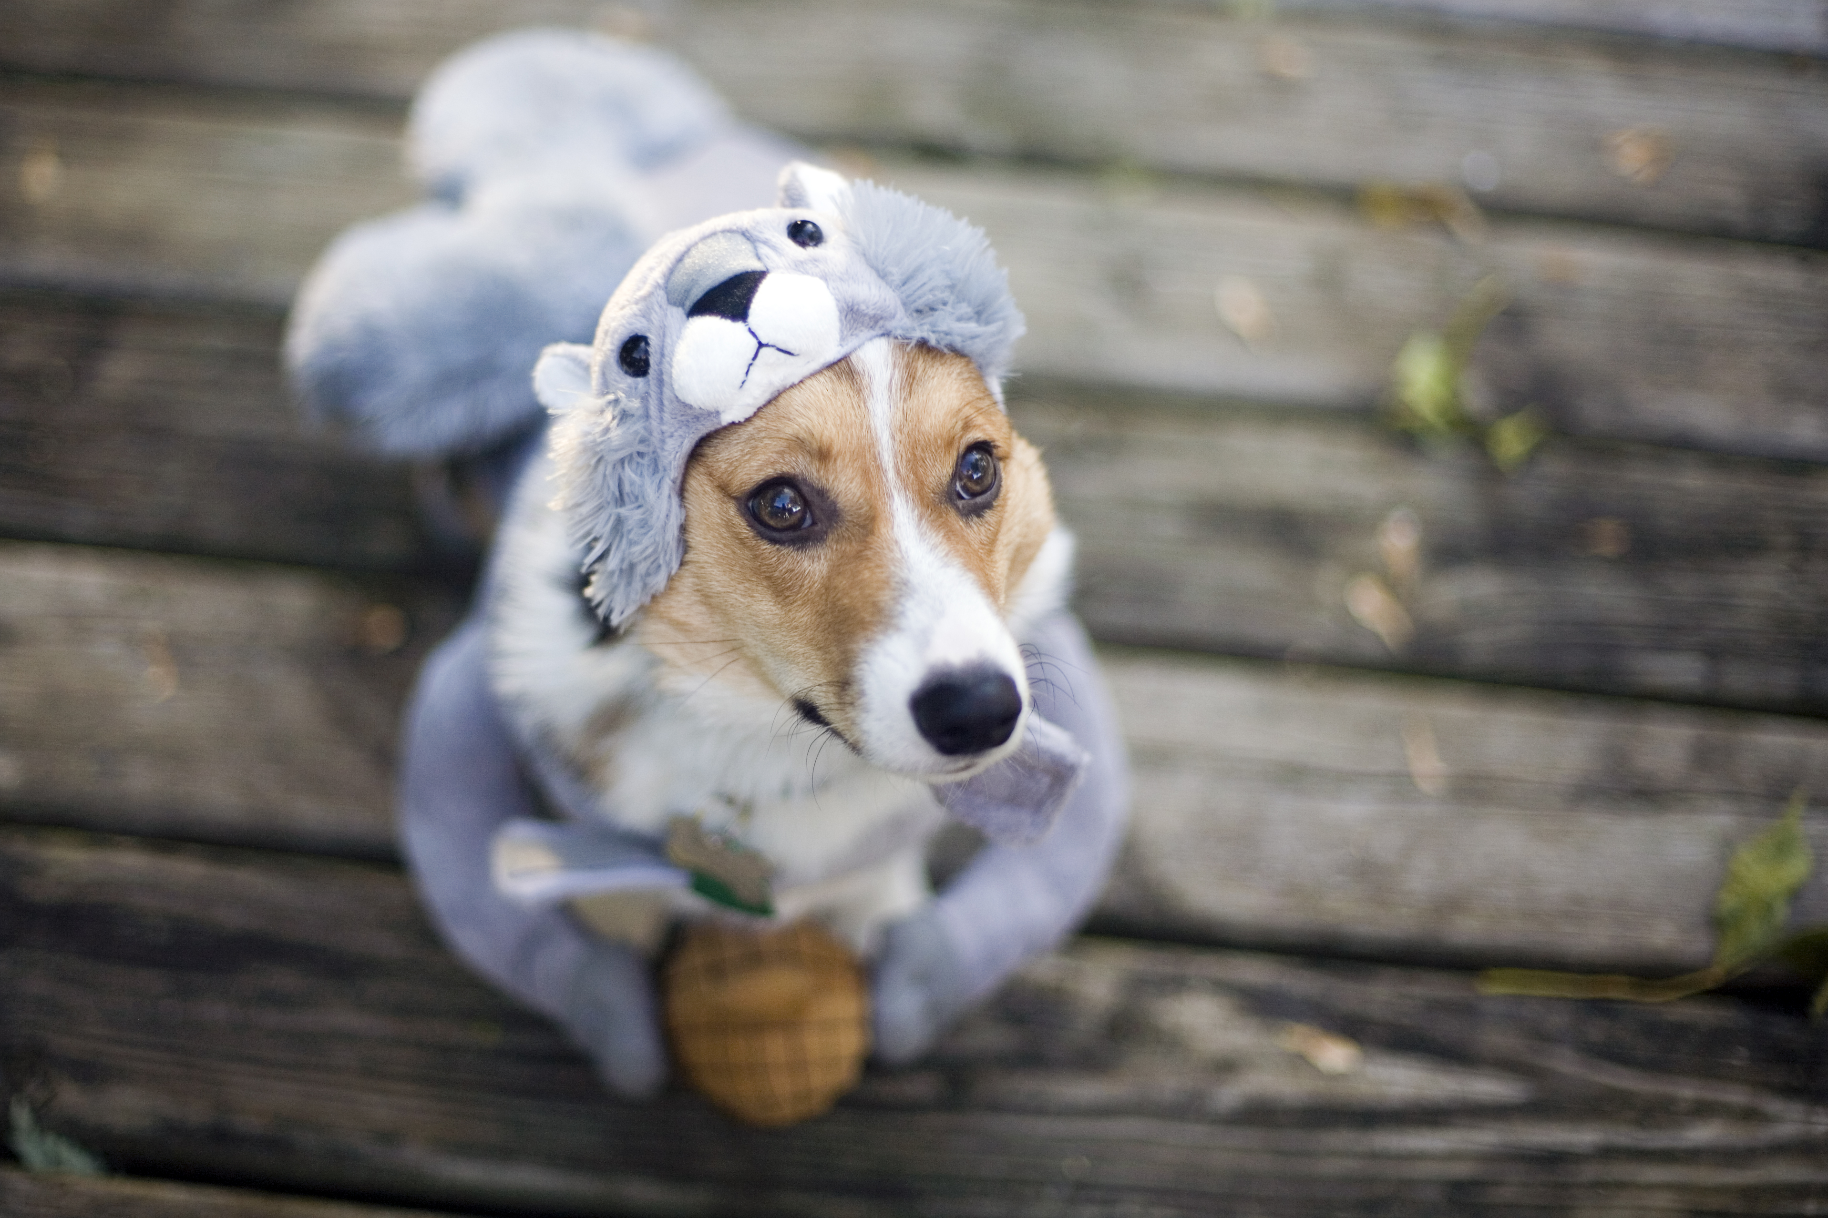
Overview
How do you make a decision?
What helps to a make decision?
Do you sometimes make the wrong decision?
Are you sometimes unable to decide?
Is it better to decide slowly or quickly?
What would make you change a decision?
What happens when times runs out?
Who decides first gets to choose?

Slide 3
Will I walk or will I bike?

Slide 4



Will I Decide to Walk or Bike?

Slide 5
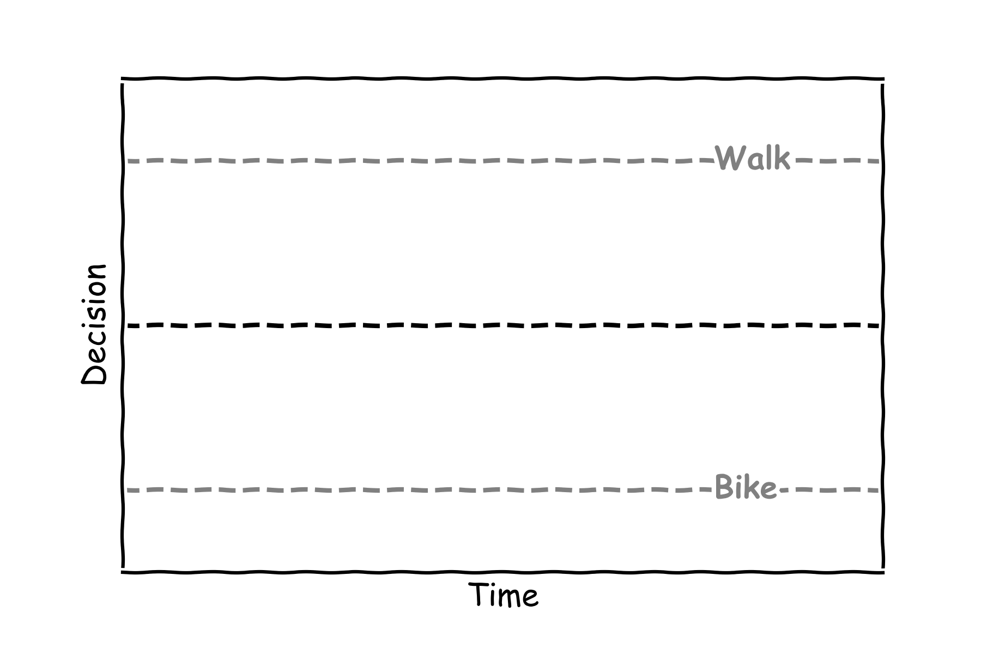
Will I Decide to Walk or Bike?

Slide 6
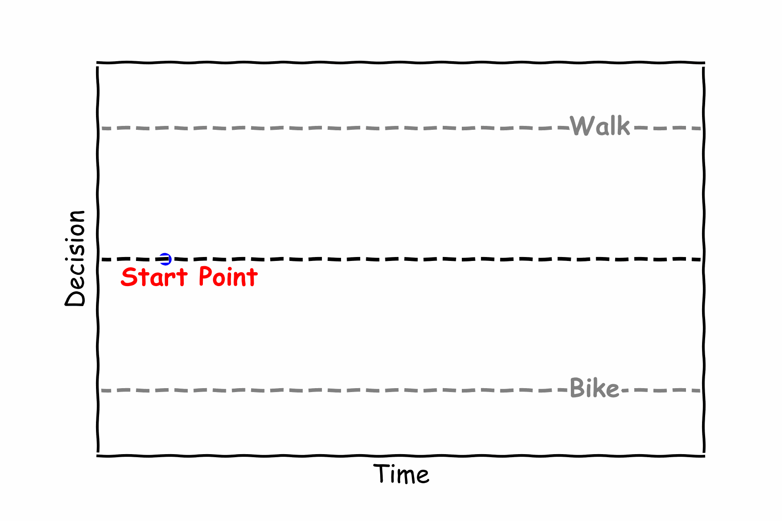
Will I Decide to Walk

Slide 7
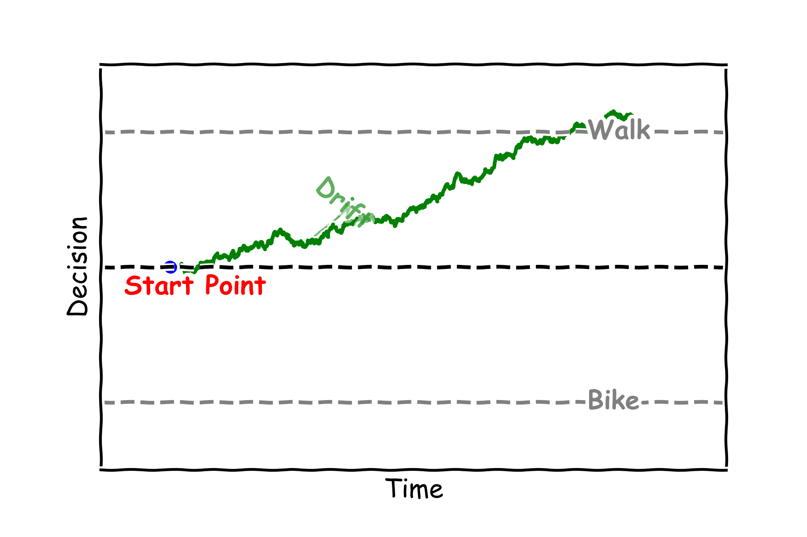
I Will Decide to Walk

Slide 8
Will I Decide to Bike

Slide 9
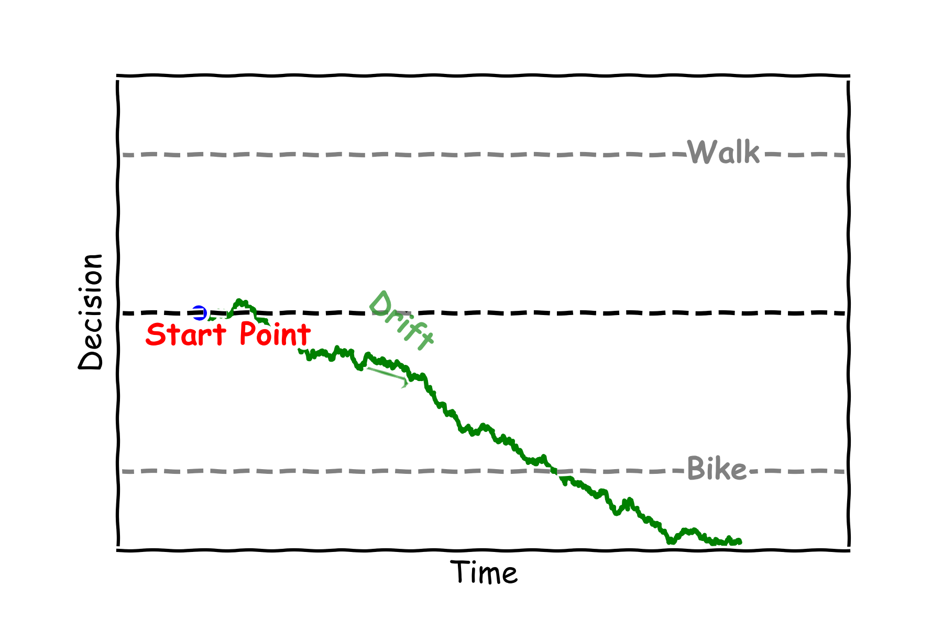
I Will Decide to Bike

Slide 10
A Mathematician’s Thinking
Decision
=

Slide 11
A Mathematician’s Thinking
Decision
=

Slide 12
A Mathematician’s Thinking
Decision
=
Drift multiplied by Time

Slide 13
A Mathematician’s Thinking
Decision
=
Drift multiplied by Time
+
Noise

Slide 14
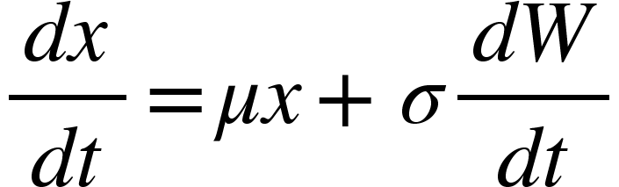
A Mathematician’s Thinking
Drift multiplied by Decision
Change of Decision
=
+
Noise

Slide 15
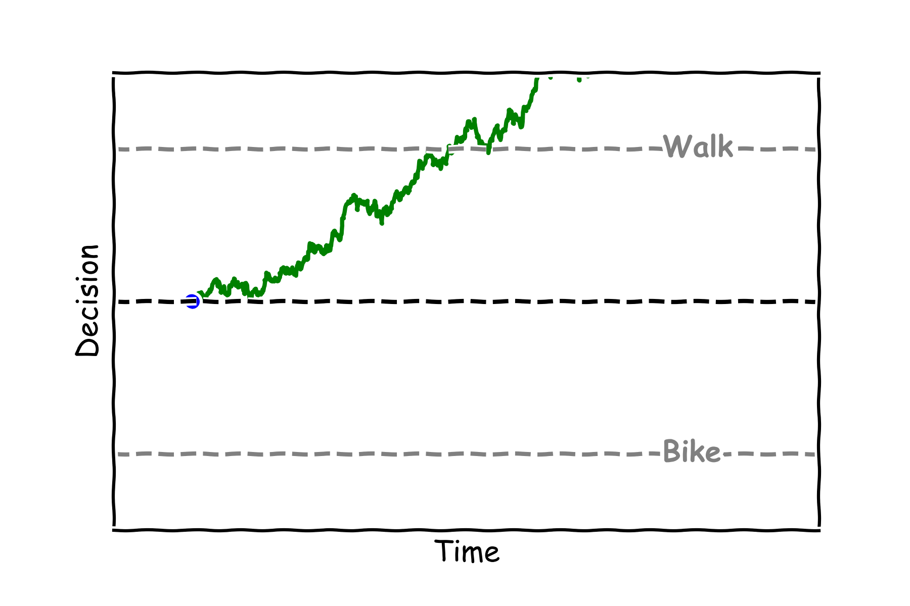
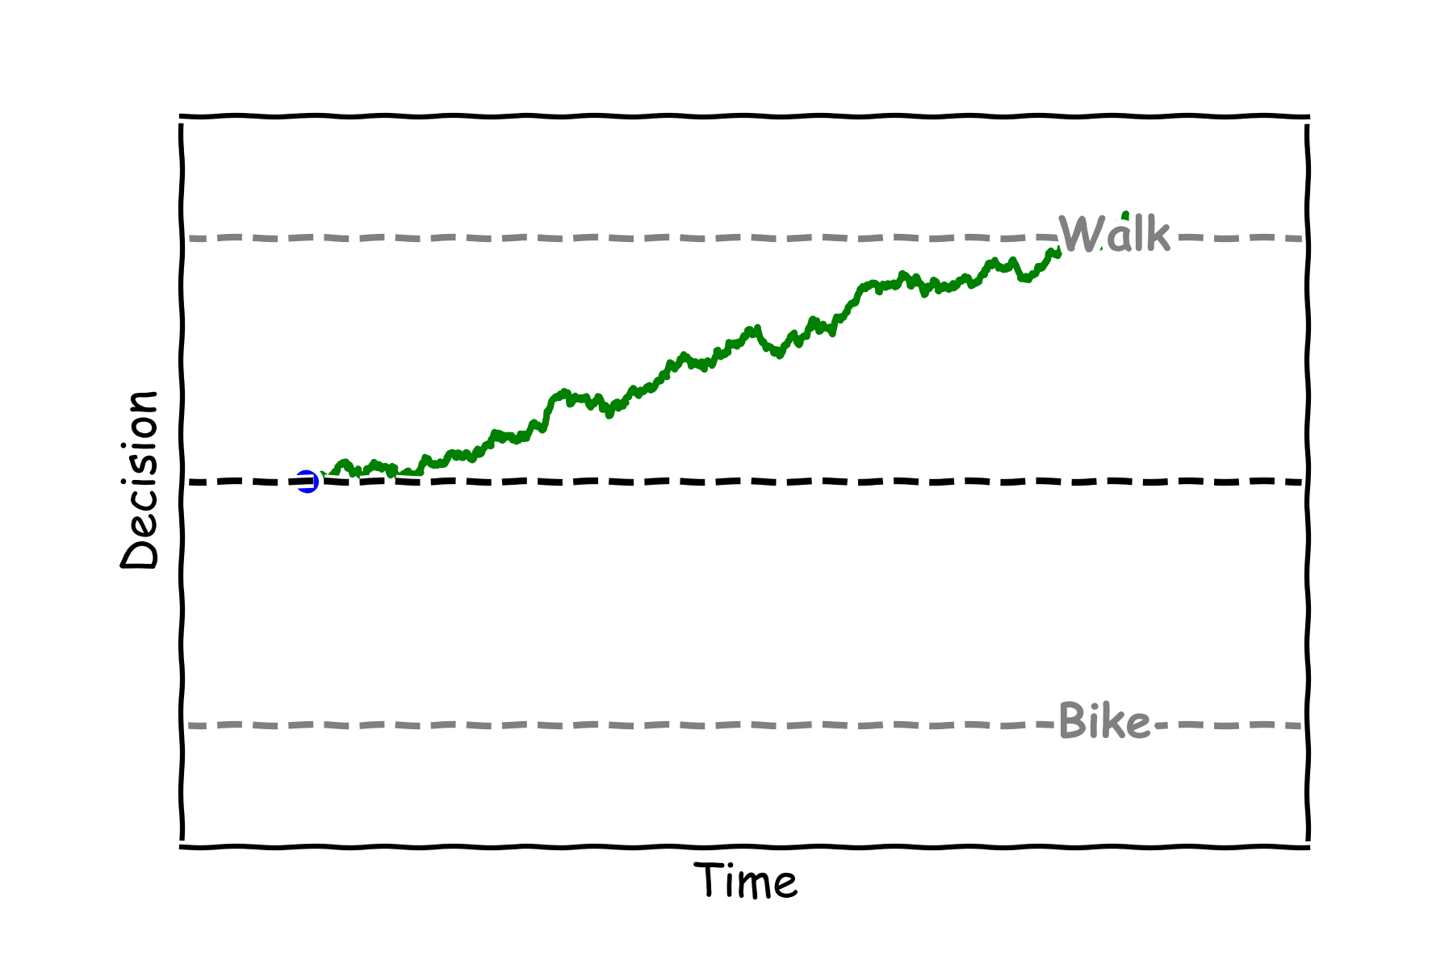
Question
Will a large drift make a decision?
Faster
Slower

Slide 16
Cannot decide

Slide 17
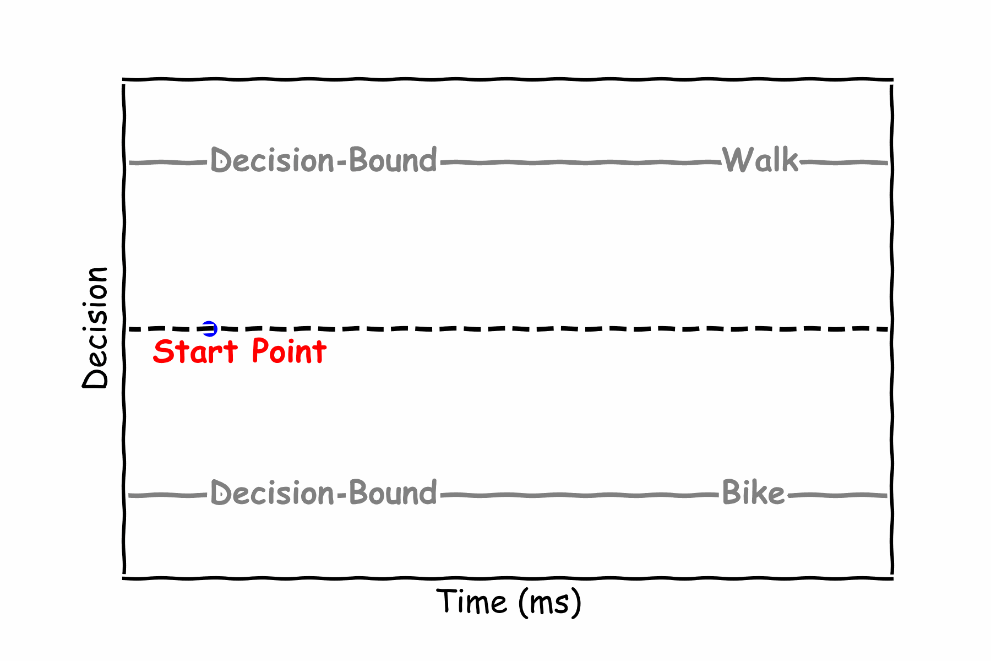
No evidence
Notes:
Maybe we can make the time dt much bigger so we see that the decision goes up and down but eventually remains close to the center
It could be nice also to picture the noise with a simple animation of footsteps wandering but remaining around the starting position. These two animations could be combined.

Slide 18
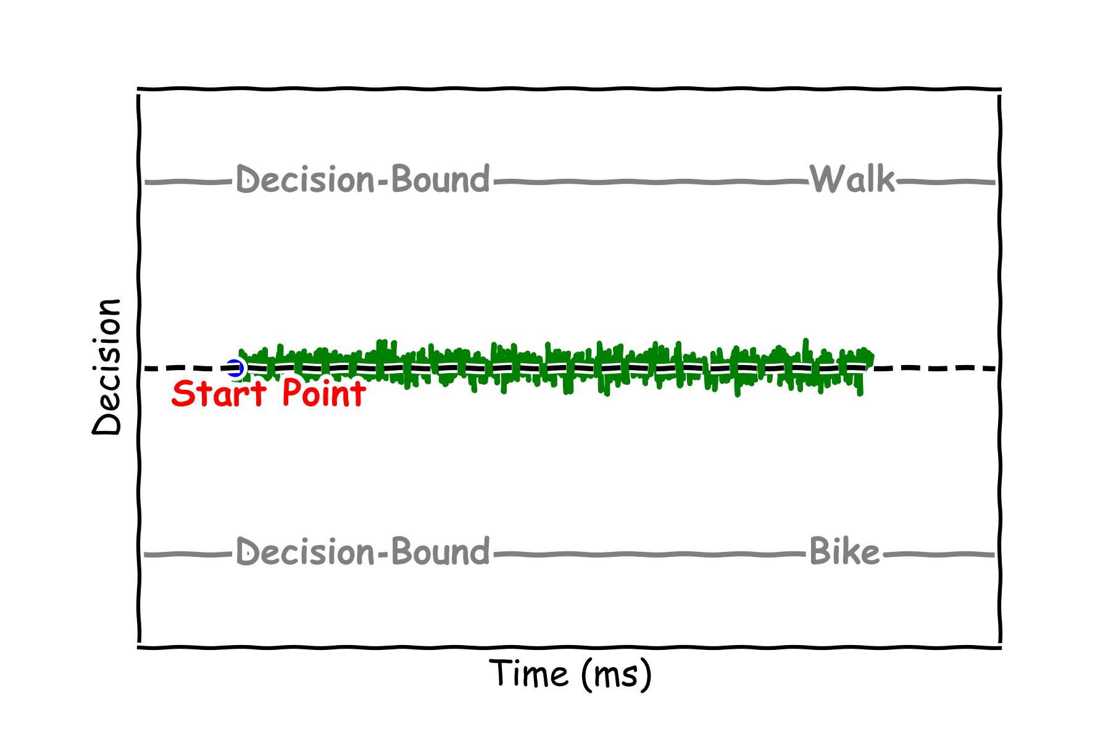
No evidence
Notes:
Maybe we can make the time dt much bigger so we see that the decision goes up and down but eventually remains close to the center

Slide 19
Question
What would make it hard to decide to bike or walk?
You only love walking
You only love biking
You love both walking and biking the same

Slide 20
A sunny day

Slide 21
Will I Decide to Walk or Bike?

Slide 22
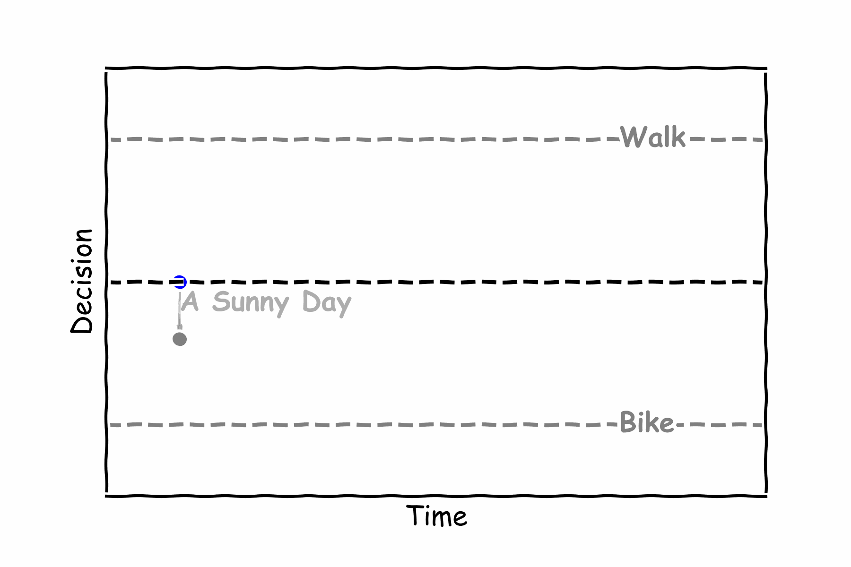
Will I bike on a sunny day?

Slide 23
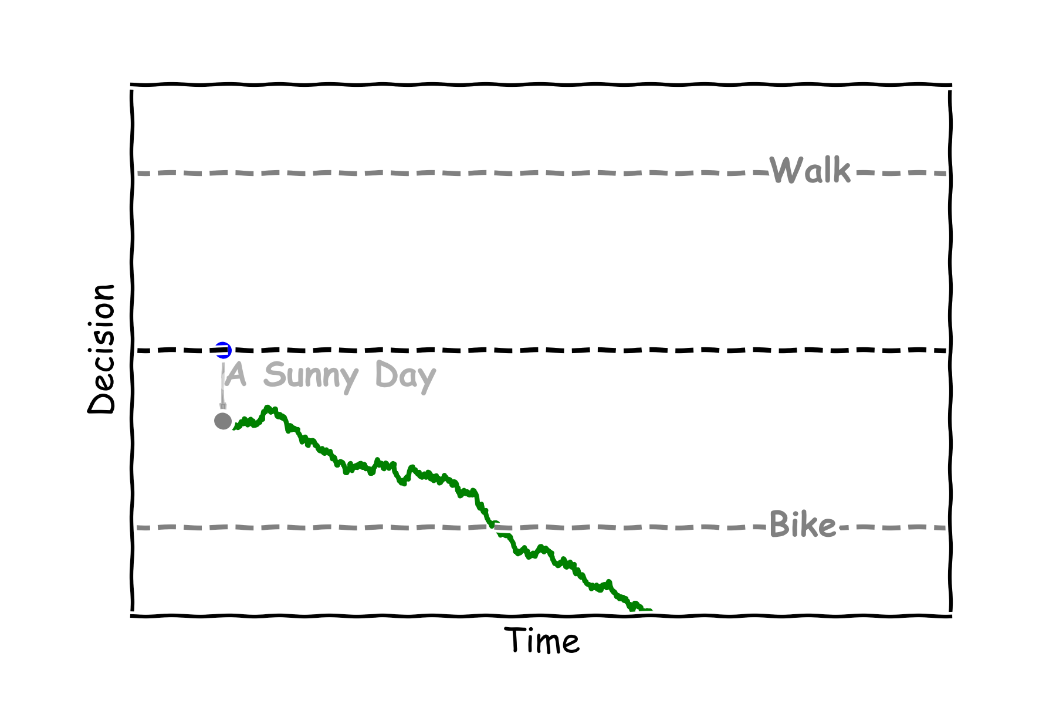
Will I bike on a sunny day?

Slide 24
Question
What would make you prefer to walk?
Better bike paths
New bike
A friend is walking

Slide 25
Will I change my mind?

Slide 26
Will I change my mind?

Slide 27
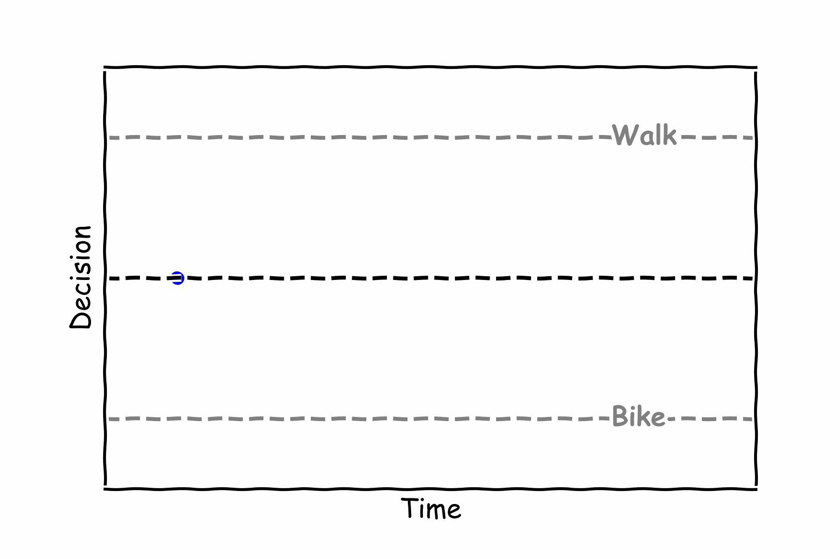
Will I change my mind?

Slide 28
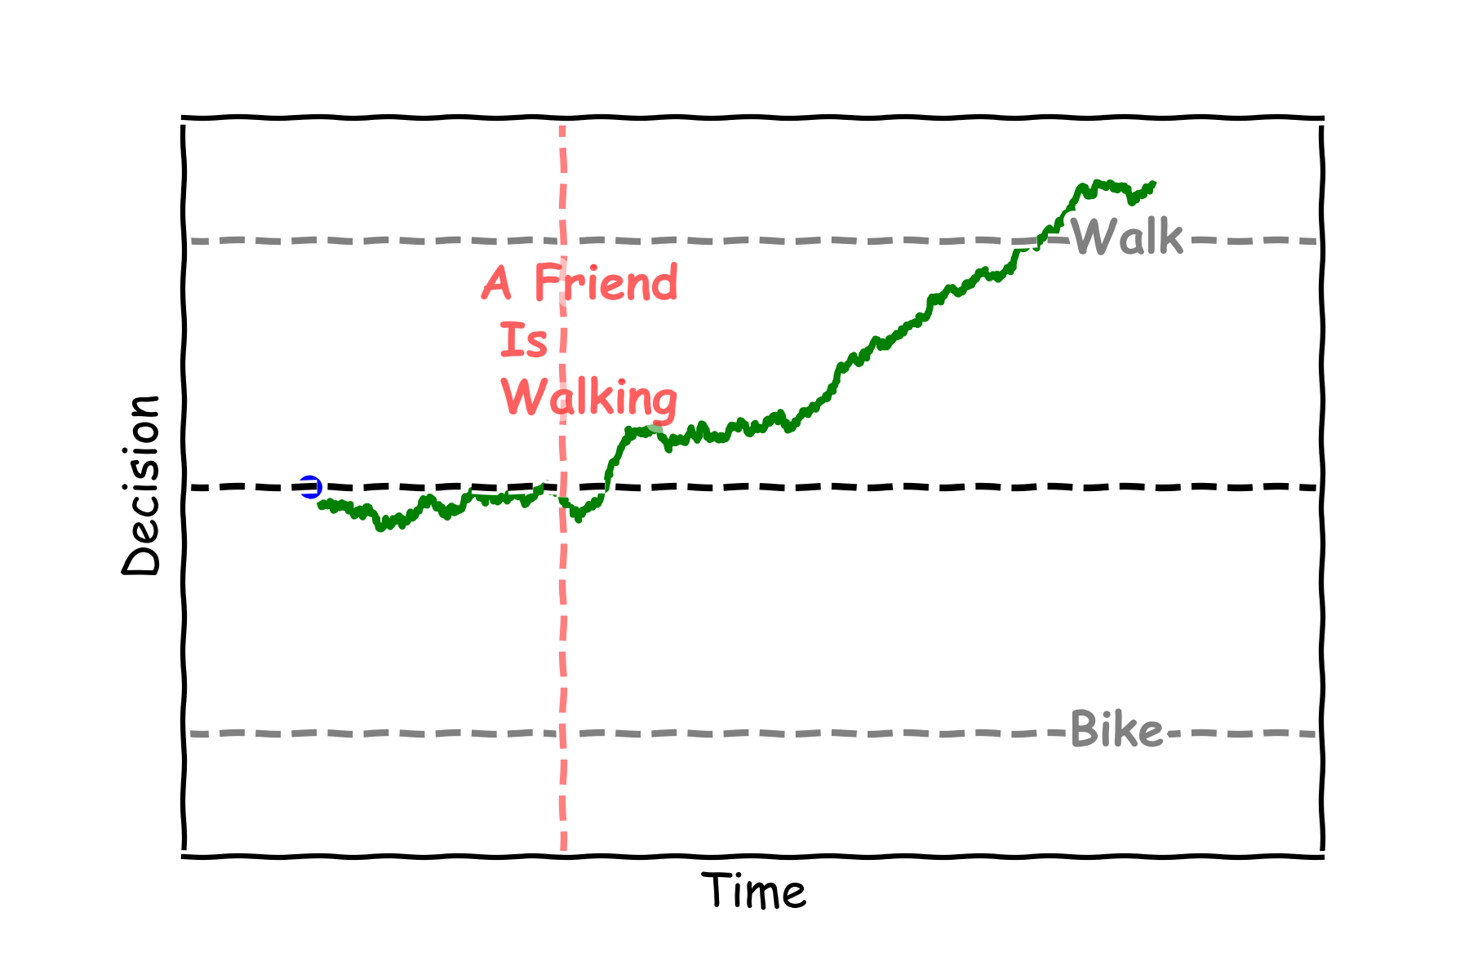
Will I change my mind?

Slide 29
Question
If you were thinking of biking but then you see a “no bike” sign would that change your decision?
Yes
No
Notes:
Options:
New elements of context (to reformulate: it would mean “new evidence”)

Slide 30
Time’s running out

Slide 31
Time’s running out

Slide 32
Time’s running out

Slide 33
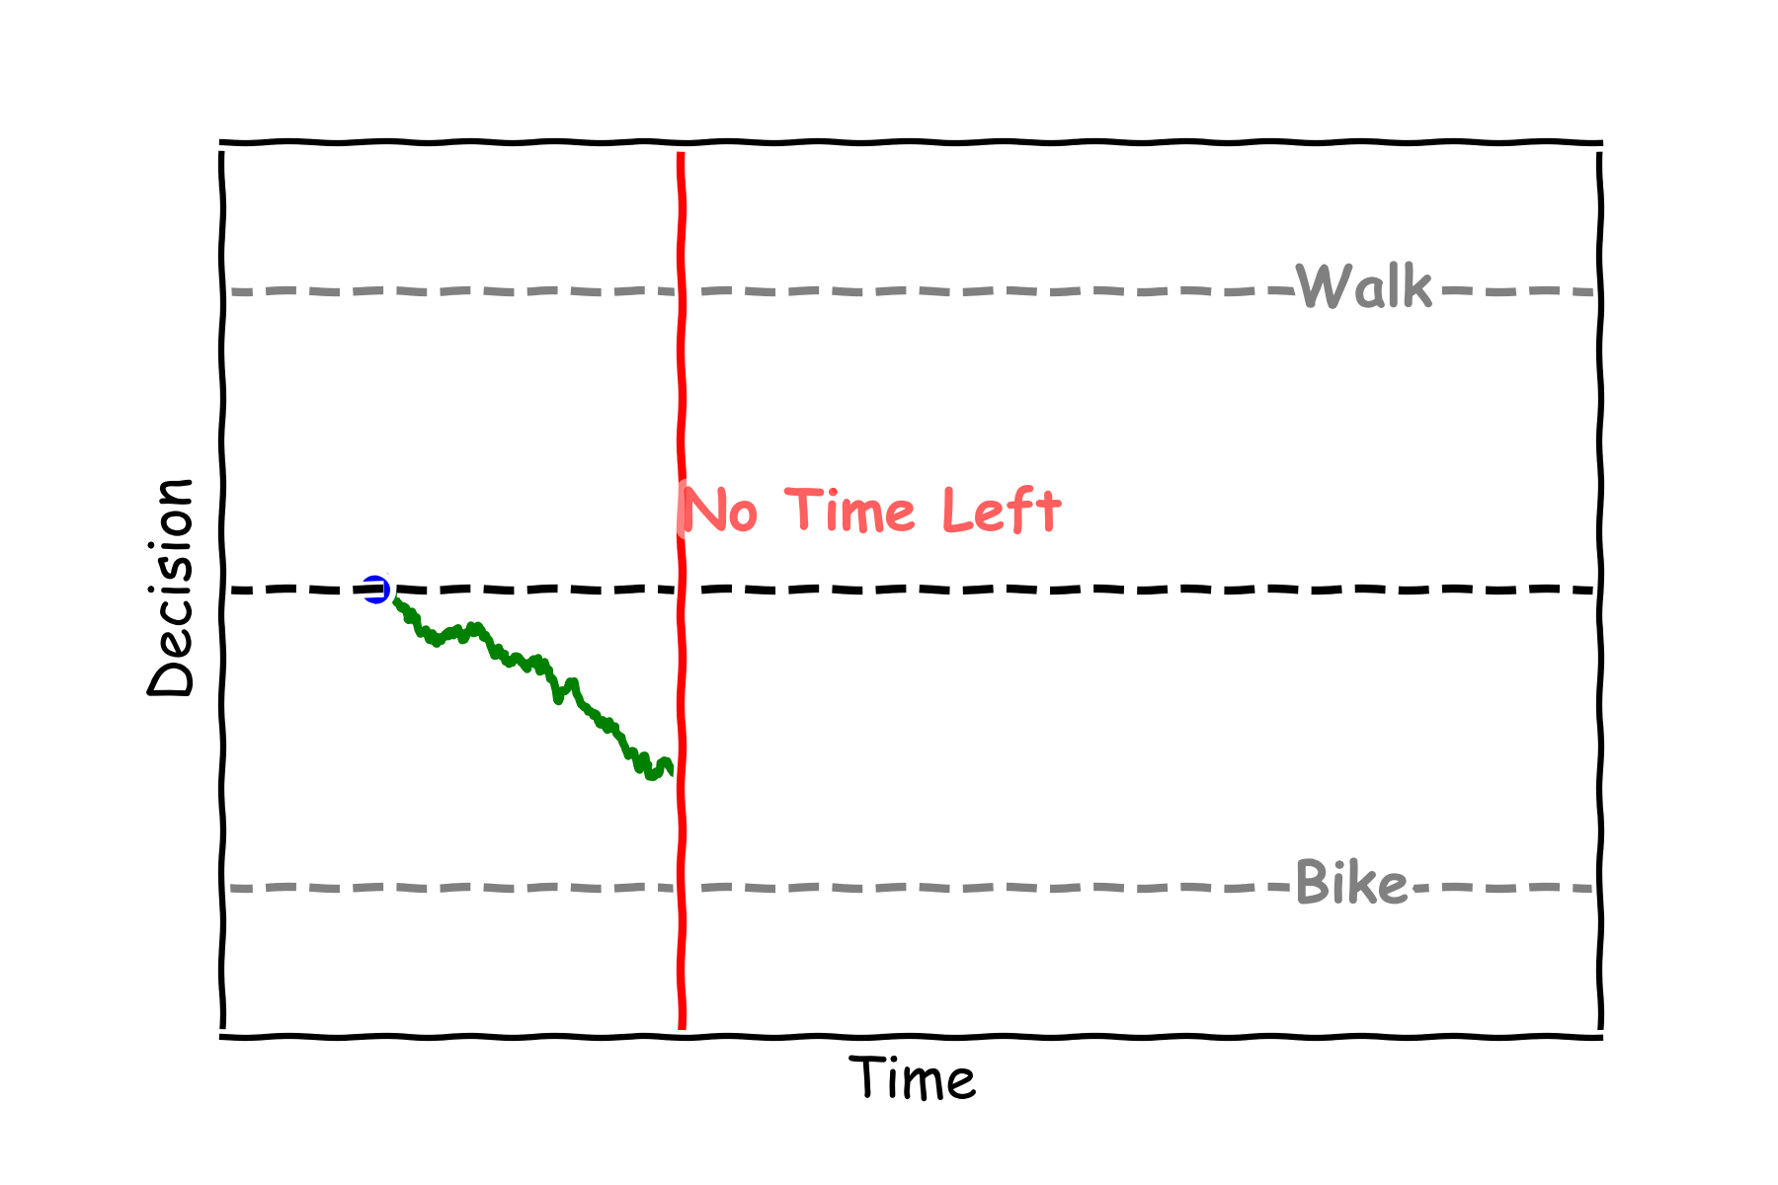
Time’s running out

Slide 34
Question
What decision was made when we ran out of time?
Bike
Walk

Slide 35
Siblings deciding

Slide 36
Who will decide first?

Slide 37
Who will decide first?
Notes:
Is it possible to have the “end” of the curve with a small image (like a drawing of a girl and one of the boy, instead or in addition to the legend)

Slide 38
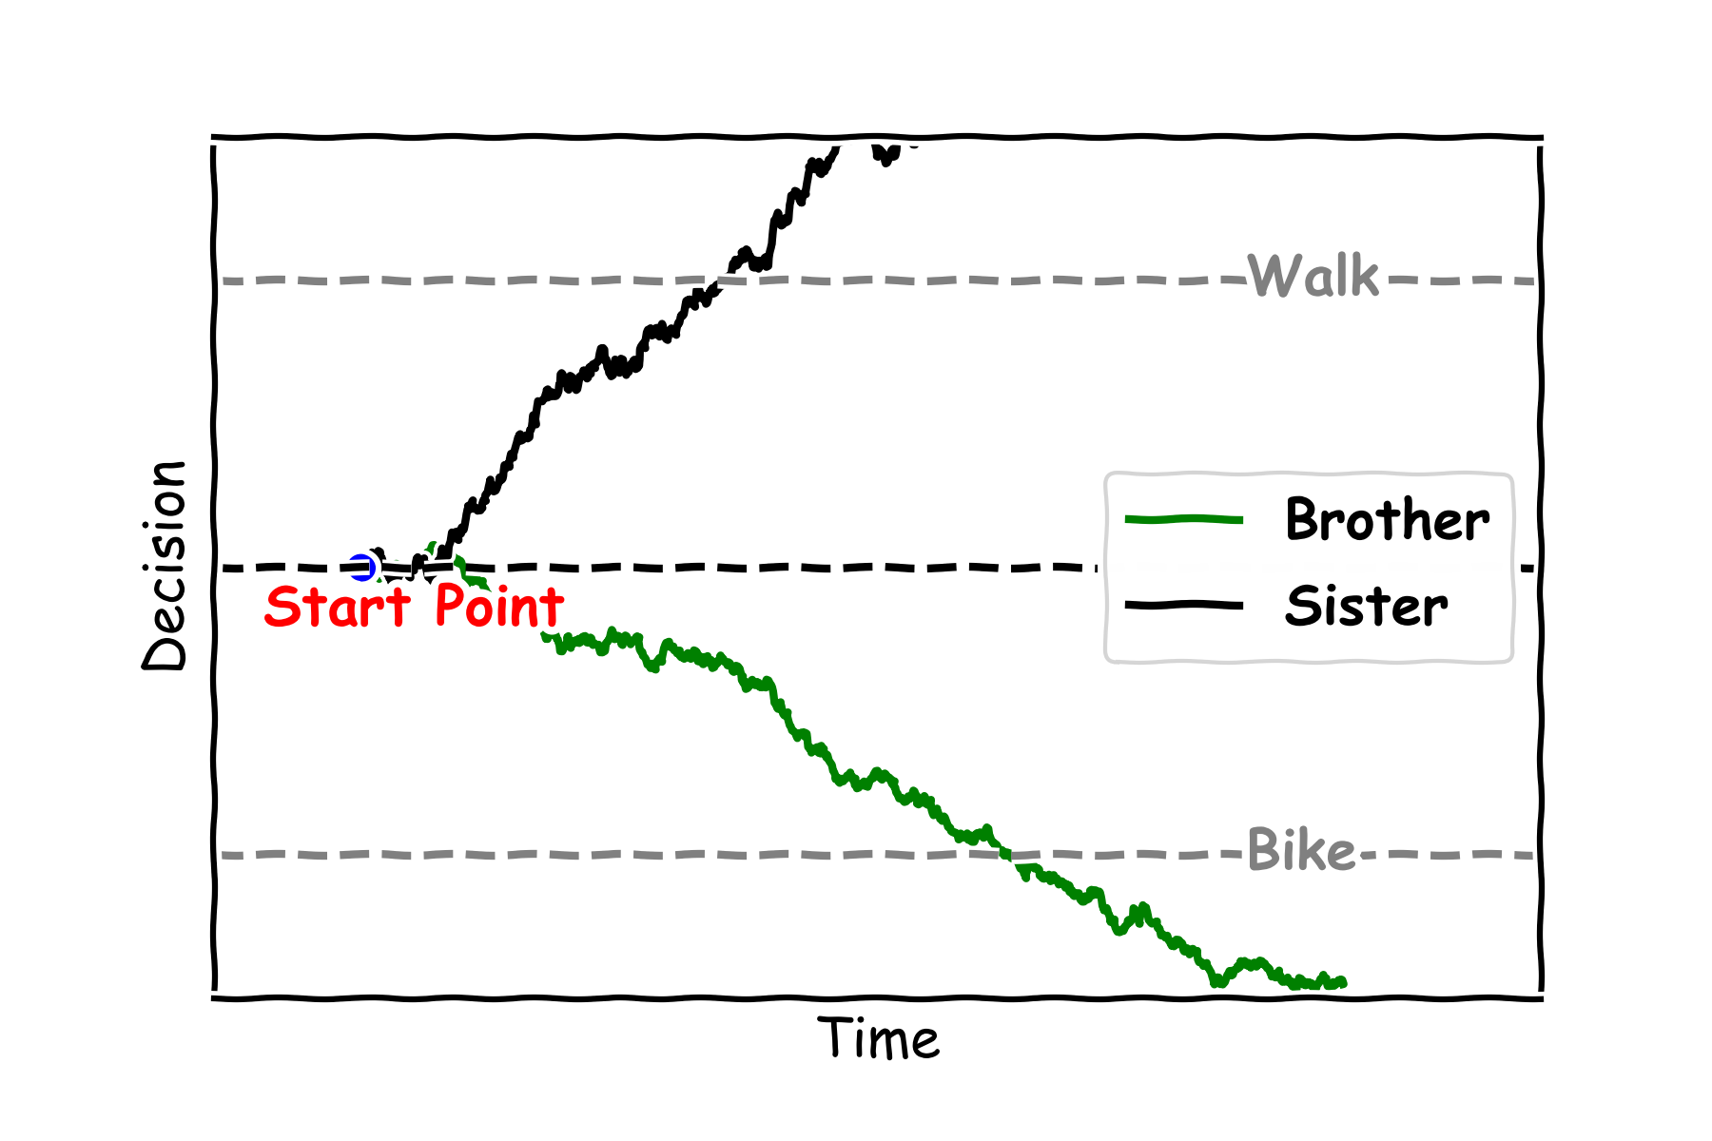
Who will decide first?

Slide 39
Question
How will the brother and sister get to school?
Walk
Bike

Slide 40
Wrap-up
Notes:
Well done for getting this far, and thanks so much for being a part of neuromatch for kids!

Slide 41
Do I Walk or Bike?
Notes:
Even making a simple decision like, do I walk or do I bike might SEEM simple. But the cool thing is that actually, the SAME mathematics can be used for decisions like, will I turn left, will I turn right? Will I eat something, will I not eat something, will I make a decision at all?
These mathematics scale up to make very big decisions, or very small decisions.
And another great thing about these mathematics is, they describes what’s actually happening in the brain.
So the type of math you learned today really can be used to get insights into how the brain works. That’s really cool and exciting!

Slide 42
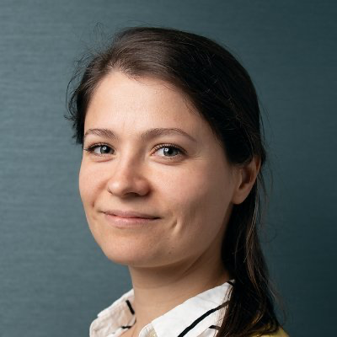




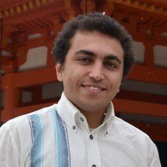

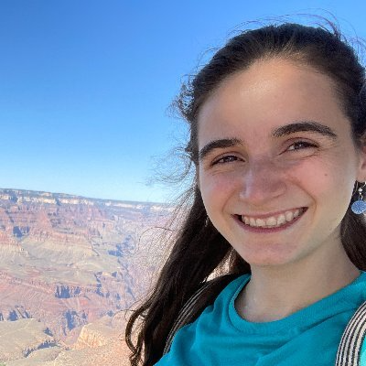

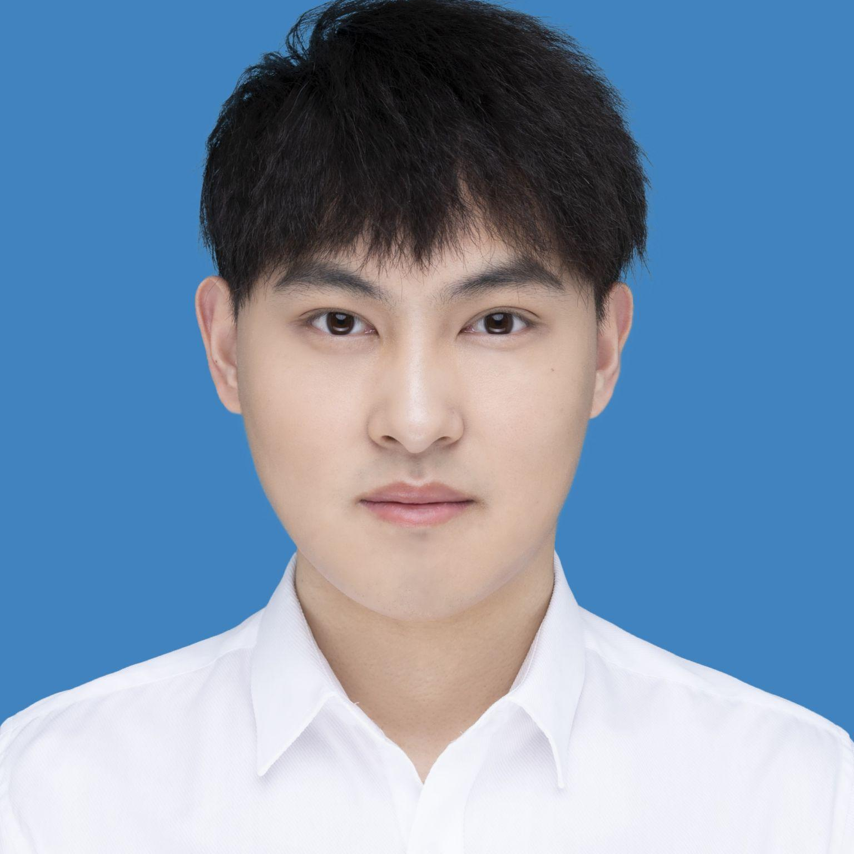
Thank you
Anne Urai
Dante Kienigiel
Isabelle Hoxha
Jeremy Forest
John Butler
Mohamed Abdelhack
Megan Peters
Noga Mudrik
Ru-Yuan Zhang
Xinquan Lu
Notes:
We hope you had fun today!
I’d like to thank you on behalf of myself and all the people who helped make this fun activity possible, for going on this journey with us and for escaping our escape room! There are also versions of this escape room in other languages like Arabic, Chinese, French, Hebrew and Spanish. Thanks again!

